Slide 1

CentraSite - WSO2 - Governance
IF4050 - Service-Oriented Architecture
Presented by:
Michael Ingga Gunawan / 13511053
Iskandar Setiadi / 13511073
Pandu Kartika Putra / 13511090

Slide 2
SOA Governance
CentraSite
WSO2 Governance

Slide 3
SOA Governance
→ A concept used for activities to exercising control over services in SOA solutions.
Key components (IBM):
Organizational change → to support SOA
Service lifecycle management → next slide
Enforcement → ensure the service policy is followed
Quality → create end-to-end process for development
Policy → manage the rules associated with services
Security → who is allowed to own and access services

Slide 4
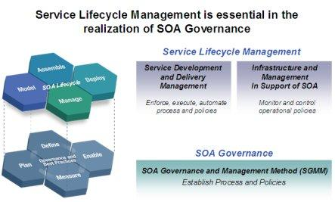
Service Lifecycle Management

Slide 5
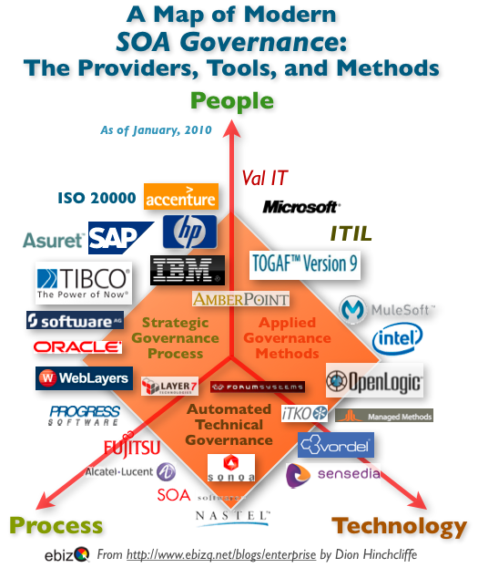

Slide 6

CentraSite
CentraSite → Lifecycle Management Tool and Enterprise Catalog
“Ensuring SOA success with effective, automated control throughout lifecycle”
APIs
SOA
Related assets

Slide 7
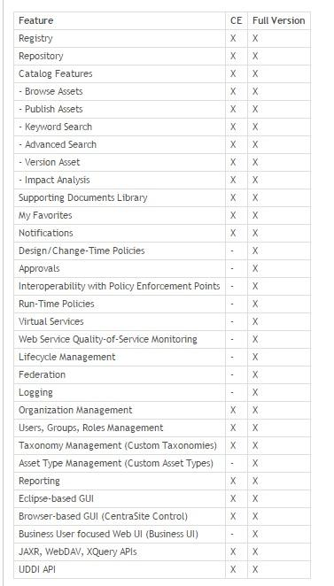
Feature
CE vs Full Version

Slide 8
CentraSite Main Features
Integrated registry / repository
CentraSite unifies registry / repository which provides company a single system of record for information regarding SOA assets and SOA governance artifacts.
Active policy management
CentraSite allows company to create policies that can automatically engage (reduce the approval and monitoring bottleneck)

Slide 9
CentraSite Main Features (Cont.)
Full lifecycle management
CentraSite automates design-time, run-time, and change-time governance in a highly integrated environment, providing one system of record.
Extensibility
CentraSite ships with pre-loaded functionality including policies, best practices, metadata models, and user roles. The solution is also easily customizable to accommodate unique policies and practices and existing IT governance constructs.

Slide 10
CentraSite Preloaded Policies and Best Practices
• Metadata validation
• WS-I Compliance Check
• WSDL Validation
• Asset Certification
• Approval Workflow
• Setting Attribute Values
• Entity Promotion
• WS-Security
• Monitoring & Alerts
• Routing
• SLAs
• Depreciation
• Failover
• Logging

Slide 11

WSO2 Governance
WSO2 ← Open source application providing SOA solutions.
WSO2 Governance Registry ← provides the right level of structure straight out of the box to support SOA Governance, configuration governance, development process governance, design and run-time governance, lifecycle management, and team collaboration.

Slide 12
WSO2 Governance: Feature
→ Storing, cataloging, indexing, and managing the enterprise metadata in a simple and scalable model
Detail: Registry & repository, SOA governance, configuration governance, development process governance, framework for governance, lifecycle management, manage & monitor, etc.

Slide 13
